Slide 1
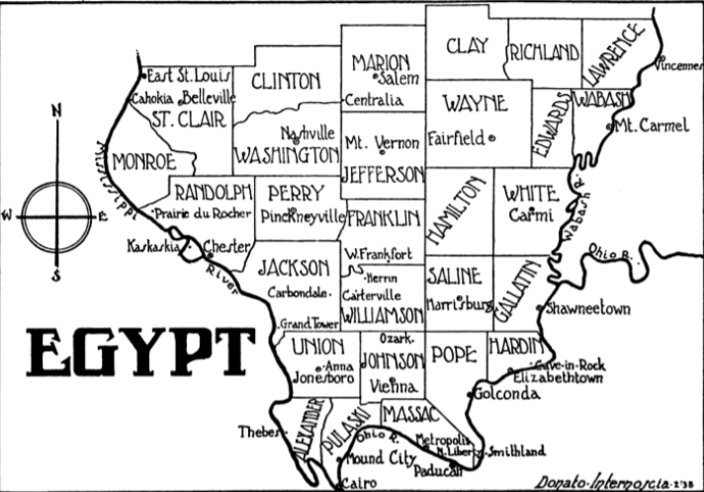

Investing in Little Egypt Through Encouraging Remote Work Positions
First of all; WHY?
Where is the data from, and how did I get it?
Decisions about data cleaning
How the final dataset was created
How is this useful to anyone?
What I learned

Slide 2
Remote investment in rural communities
The vast majority of the United States is more rural than urban, and not everyone can live in a large city. Rural areas like Southern Illinois are largely forgotten about and often left to flounder in poverty. One way to encourage economic development is to target these areas when recruiting for remote positions. This project uses the tech/development sector as an example, but tele-medicine, tele-teaching, and other remote options are just as feasible.

